Slide 1


UNIVERSITY COLLEGE OF ENGINEERING
NARASARAOPET-JNTUK
Design and Implementation of Integrated Fire Detection and Personnel Accountability System
PROJECT SUPERVISOR
Mr.S.V.Sai Prasad
Asst.Professor(C)
Dept. Of ECE
UCEN-JNTUK
PROJECT ASSOCIATES (BATCH-13)
1.20031A0453-V.V.S.Naveen
2.20031A0405-B.Sai Balaji
3.20031A0409-CH.Lokabhiram
4.20031A0455-Y.Upendra

Slide 2
CONTENTS
Abstract
Introduction
Existing Methods
Proposed Method
Block Diagram
Tools/Software Required
Algorithm
FlowChart
Results
Modules of Work
References

Slide 3
Abstract
Objective: Develop an integrated safety system using image processing and deep learning for effective fire incident detection and response.
Approach: Utilize Faster R-CNN to detect suspected fire regions, employ LSTM for short and long-term event dynamics, and use majority voting for decision-making. Monitor temporal changes in flame and smoke areas to understand fire behavior.
Response Mechanism: Activate alarms and send notifications to officials upon fire detection. Employ CCTV cameras at exit gates for individual counting during evacuations.
Outcome: Enable real-time response capabilities, ensuring occupant safety and minimizing damage in industries by comparing attendance data with counted individuals and displaying real-time counts.

Slide 4
Introduction
According to a report, In 2021, India recorded 1.6 million fire accidents, with 27,027 deaths. To reduce such disasters, fire detection without a false alarm at an early stage is crucial. Accordingly, various automatic fire detection technologies are being developed, and are widely used in real life.
To address these challenges, current research explores computer vision-based approaches. This innovative methodology provides broader surveillance coverage and faster response times by confirming fires without the need for physical inspection.
Our proposed system seamlessly integrates with existing alarm systems, ensuring immediate notifications to authorities upon fire detection.
The cross-referencing of attendance data with the evacuation count is a crucial step, enabling the system to promptly identify any disparities and trigger alerts.

Slide 5
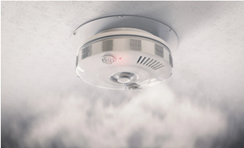
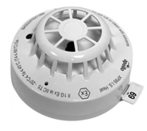
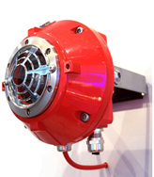
Traditional Methods
Smoke Detector
Heat Detector
Flame Detector
fig a. Smoke Detector fig b. Heat Detector fig c. Flame Detector
Traditional fire alarm technology is based on smoke or heat sensors that require proximity for activation. These sensors need human involvement to confirm a fire in case of alarm. Furthermore, such systems require various equipment to provide information on the size, location, and burning degree of the fire.

Slide 6
Proposed method
Our proposed method leverages advanced technologies like Faster R-CNN for precise spatial feature detection of both fire and non-fire regions in video sequences. This robustly identifies suspected regions of fire (SRoFs).
To understand the fire's evolution, we employ Long Short-Term Memory (LSTM) to accumulate and analyze summarized features across successive frames within the SRoFs bounding boxes.
Instead of relying solely on short-term assessments, we utilize majority voting to combine these classifications over time.
Upon confirmed fire detection, the system triggers alarms and sends notifications to emergency personnel.
Additionally, CCTV cameras at exit gates enable the counting of evacuated individuals, allowing for discrepancy checks against attendance data. This ensures real-time response and accountability for occupant safety.

Slide 7
BLOCK DIAGRAM
FIRE DETECTION
FIRE ALARM NOTIFICATION AND EVACUATION MONITORING
Image Processing
(Faster R-CNN)
Deep Learning
(LSTM)
Alarm Activation and Notification (E-Mail)
Spatial Features
Temporal Features
CCTV Cameras at Exit Gates for Personnel Accountability
Majority Voting for Decision Making
Attendance Comparision and push the count to server
Dynamic Fire Behavior Analysis

Slide 8
Software Required
Deep Learning Frameworks
1. Faster R-CNN 2. LSTM
Computer Vision Libraries
1. OpenCV 2.torch
IDE (Integrated Development Environment)
1. Visual Studio Code 2. Google Colaboratory
Alarm and Notification System
1. playsound 2. smtplib
Database Management System
1. PostgreSQL
Documentation Tools
1. Microsoft Word 2. Canva
Collaboration Tools
1. Microsoft Teams 2. Zoom

Slide 9
Algorithm
STEP-1: Preprocessing:
Load pre-trained Faster R-CNN and ResNet model for detecting and extracting fire regions.
Define preprocessing transformations for resizing frames and converting them to tensors.
STEP-2: Detection:
Faster R-CNN model is used for detecting suspected fire regions in video frames.
Bounding boxes are drawn around detected fire regions for visualization and analysis.
STEP-3: Feature Extraction:
Utilizes a pre-trained ResNet model to extract features from suspected fire regions in video
Features are then fed into a trained LSTM model for classification.
STEP-4: Classification:
LSTM model classifies extracted features as representing either fire or no fire.
Trained on labelled data to learn patterns indicative of fire incidents.
STEP-5: Action:
Upon detection of an actual fire, triggers an emergency alarm sound.
Optionally, sends email notifications to alert relevant authorities about the fire incident.

Slide 10
Algorithm
STEP-6: Background Visitor Counter:
Implement a function to continuously monitor the video stream for visitor movement.
Track visitors' movement across predefined lines in the frame to count entries and exits.
STEP-7: Flask API:
Define a Flask route (/visitor_count) to retrieve and display the current visitor count.
Start the Flask app in a separate thread to handle HTTP requests concurrently.
STEP-8: Personnel Accountability System:
Apply background subtraction to detect moving objects (presumably visitors) in the frame.
Detect when visitors cross predefined lines to count entries and exits and Update the visitor count accordingly.
STEP-9: Checking for Crossing Lines:
Specialized methods are implemented to detect when a person crosses predefined lines in frame.
These methods facilitate the accurate counting of entries and exits as visitors move within the surveillance area.
STEP-10: Disparity Detection and Alerts:
Attendance Comparison and push the count to the server.
Officials with access to the server can get the count from the server.

Slide 11

FLOWCHART
Repeat again from preprocessing
Start
NO
Is it an actual fire?
Input(Video)
YES
Preprocessing
Trigger emergency alarm and send email notification
Attendance tracking system record personnel entry and exit times.
NO
End
Are fire regions detected?
YES
Comparision of people movement and push the difference to server.
Extract and Feed features into LSTM for classification
End

Slide 12
Input (Video): This is where the process begins, with a video feed being provided as input.
Preprocessing: The video feed undergoes preprocessing to extract relevant features. This step involves preparing the data for analysis, which may include tasks such as resizing, normalization, or feature extraction.
Extract and Feed Features into LSTM for Classification: The extracted features are thenfed into a Long Short-Term Memory (LSTM) neural network for classification. LSTM isa type of recurrent neural network (RNN) capable of capturing long-term dependencies insequential data.
Is it an actual fire? After classification, the system determines whether the event detected inthe video represents an actual fire.
NO: If the event is not classified as a fire, the process ends here.
YES: If the event is classified as a fire, the flow continues to the next step.
Are fire regions detected? The system checks whether specific regions indicative of fire aredetected within the video feed.

Slide 13
YES: If fire regions are detected, it triggers an emergency alarm and sends email notifications to alert relevant personnel about the fire emergency.
NO: If fire regions are not detected, the process proceeds to the next step.
Attendance Tracking System Records Personnel Entry and Exit Times: In this step, thesystem records the entry and exit times of personnel using an attendance tracking system.This helps in ensuring accountability and safety during emergency situations.
Repeat Again from Preprocessing: After completing the actions based on the current frameof the video, the process repeats from the preprocessing step to analyze the next frame.
Comparison of People Movement and Push the Difference to Server: The system compares the movement of people between consecutive frames to identify any significant changes or discrepancies. The differences in movement patterns are then
pushed to a serverfor further analysis or logging.
End: The process concludes here, indicating the completion of the flowchart.

Slide 14
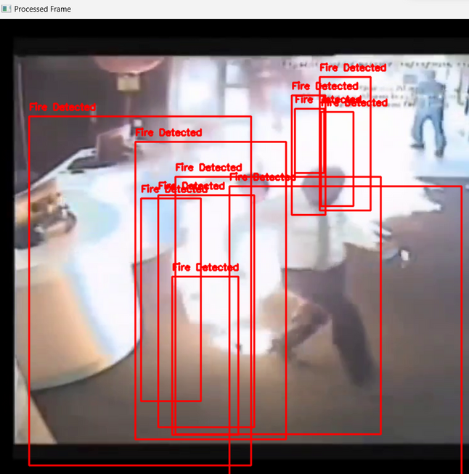
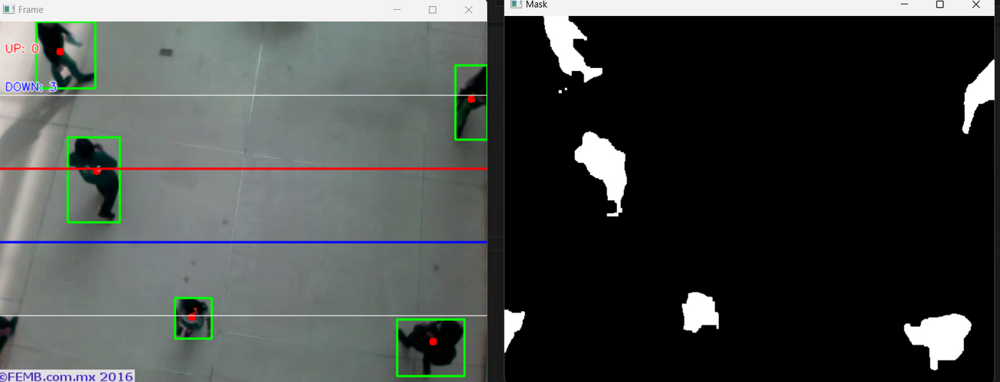
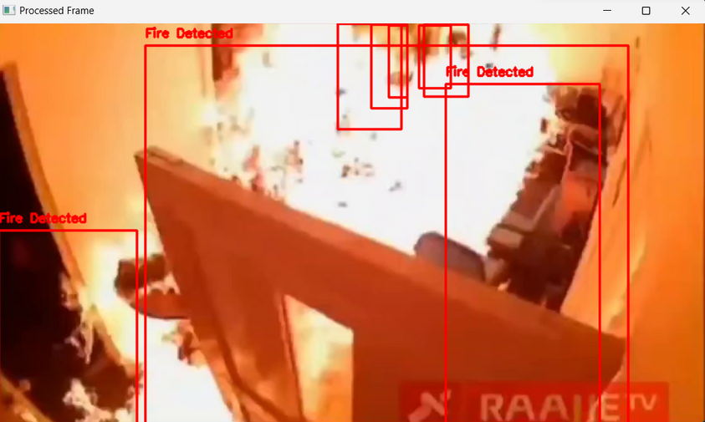
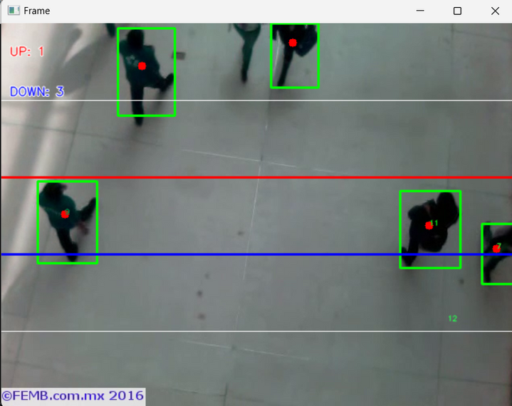
RESULTS

Slide 15
RESULTS
The fire detection system described effectively utilizes surveillance camera video streams to promptly identify and classify fire incidents with high accuracy in real-time.Upon detecting a fire, the system triggers immediate emergency alerts to enhance safety measures and facilitate timely response. These alerts may include activating emergency alarm sounds to notify individuals within the vicinity and sending email notifications to relevant authorities.CCTV Cameras at exit gate will continuously monitor the counted number of individuals during an evacuation using CCTV cameras and compare it with the attendance data. When a disparity is detected,the system will trigger an alert mechanism.

Slide 16
Modules of Work
MODULES | DURATION | STATUS
LITERATURE SURVEY | 2 WEEKS | COMPLETED
FIRE DETECTION MODULE (SOFTWARE DEVELOPMENT-1) | 3 WEEKS | COMPLETED
PERSONNEL ACCOUNTABILITY (SOFTWARE DEVELOPMENT-2) | 2 WEEKS | COMPLETED
RESULT ANALYSIS AND DOCUMENTATION | 2 WEEKS | COMPLETED

Slide 17
References
Byoungjun Kim and Joonwhoan Lee*. “A Video-Based Fire Detection Using Deep Learning Models.” 18 July 2019 in Applied Sciences
Ren, S., He, K., Girshick, R., & Sun, J. (2017). "Faster R-CNN: Towards Real-Time Object Detection with Region Proposal Networks." IEEE Transactions on Pattern Analysis and Machine Intelligence (TPAMI).
Karpathy, A., Toderici, G., Shetty, S., Leung, T., Sukthankar, R., & Fei-Fei, L. (2014). "Large-scale Video Classification with Convolutional Neural Networks." IEEE Conference on Computer Vision and Pattern Recognition (CVPR).
Panagiotis Barmpoutis1, Kosmas Dimitropoulos2, Kyriaki Kaza2, and Nikos Grammalidis2.(2019)."Fire Detection from Images using Faster R-CNN and Multidimensional Texture Analysis”
ASHRAE. (2008). "Design Manual for Smoke Control." American Society of Heating, Refrigerating and Air-Conditioning Engineers.

Slide 18
"Integrating Fire Detection Systems with Personnel Accountability Systems for Improved Emergency Response"by J. A. Martin, A. L. Rantilla, and S. J. Emery. (IEEE Xplore)
"Integrating Fire Detection and Personnel Tracking Systems for Improved Safety in Complex Environments" byS. R. Sanders, C. D. Williams, and M. A. Johnson. (ScienceDirect)
"A Framework for the Integration of Fire Detection and Personnel Accountability Systems in HighRiskEnvironments" by R. K. Smith, E. T. Brown, and T. Q. Nguyen. (ASCE Library)
"Enhancing Fire Safety through the Integration of Fire Detection and Personnel Tracking Technologies" by L. M.Chen, J. W. Wang, and K. L. Lee. (ScienceDirect)
Integrating Fire Detection Systems with Personnel Accountability Technologies: A Review of Current Approaches and Future Directions" by G. H. Park, J. Y. Kim, and S. K. Lee. (IEEE Xplore)
Intelligent Integration of Fire Detection and Personnel Accountability Systems using IoT and Machine Learning" by A. Gupta, R. Sharma, and S. Kumar. (SpringerLink)
"Toward Autonomous Emergency Response: Integration of Fire Detection, Personnel Tracking, and Robotic Assistance" by B. Johnson, D. Smith, and C. Brown. (ACM Digital Library)

Slide 19
THANK YOU

